Slide 1

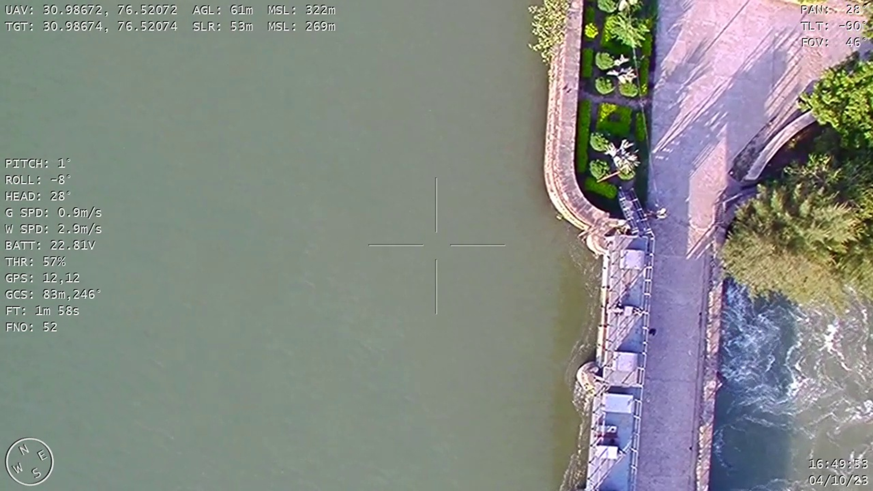
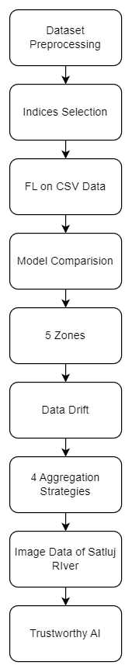
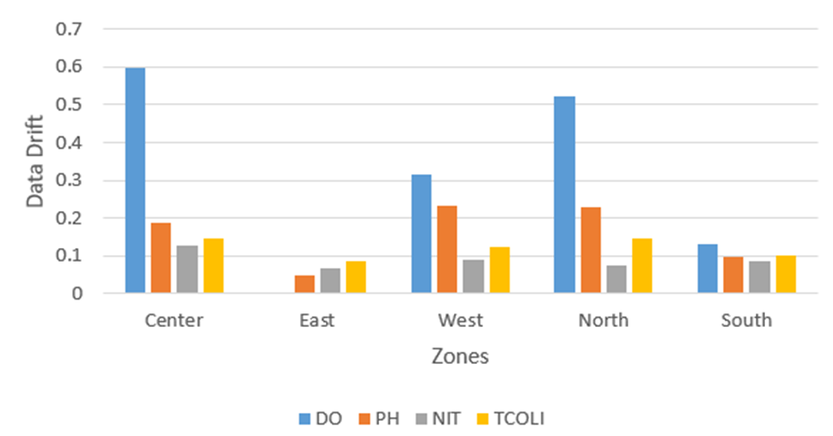
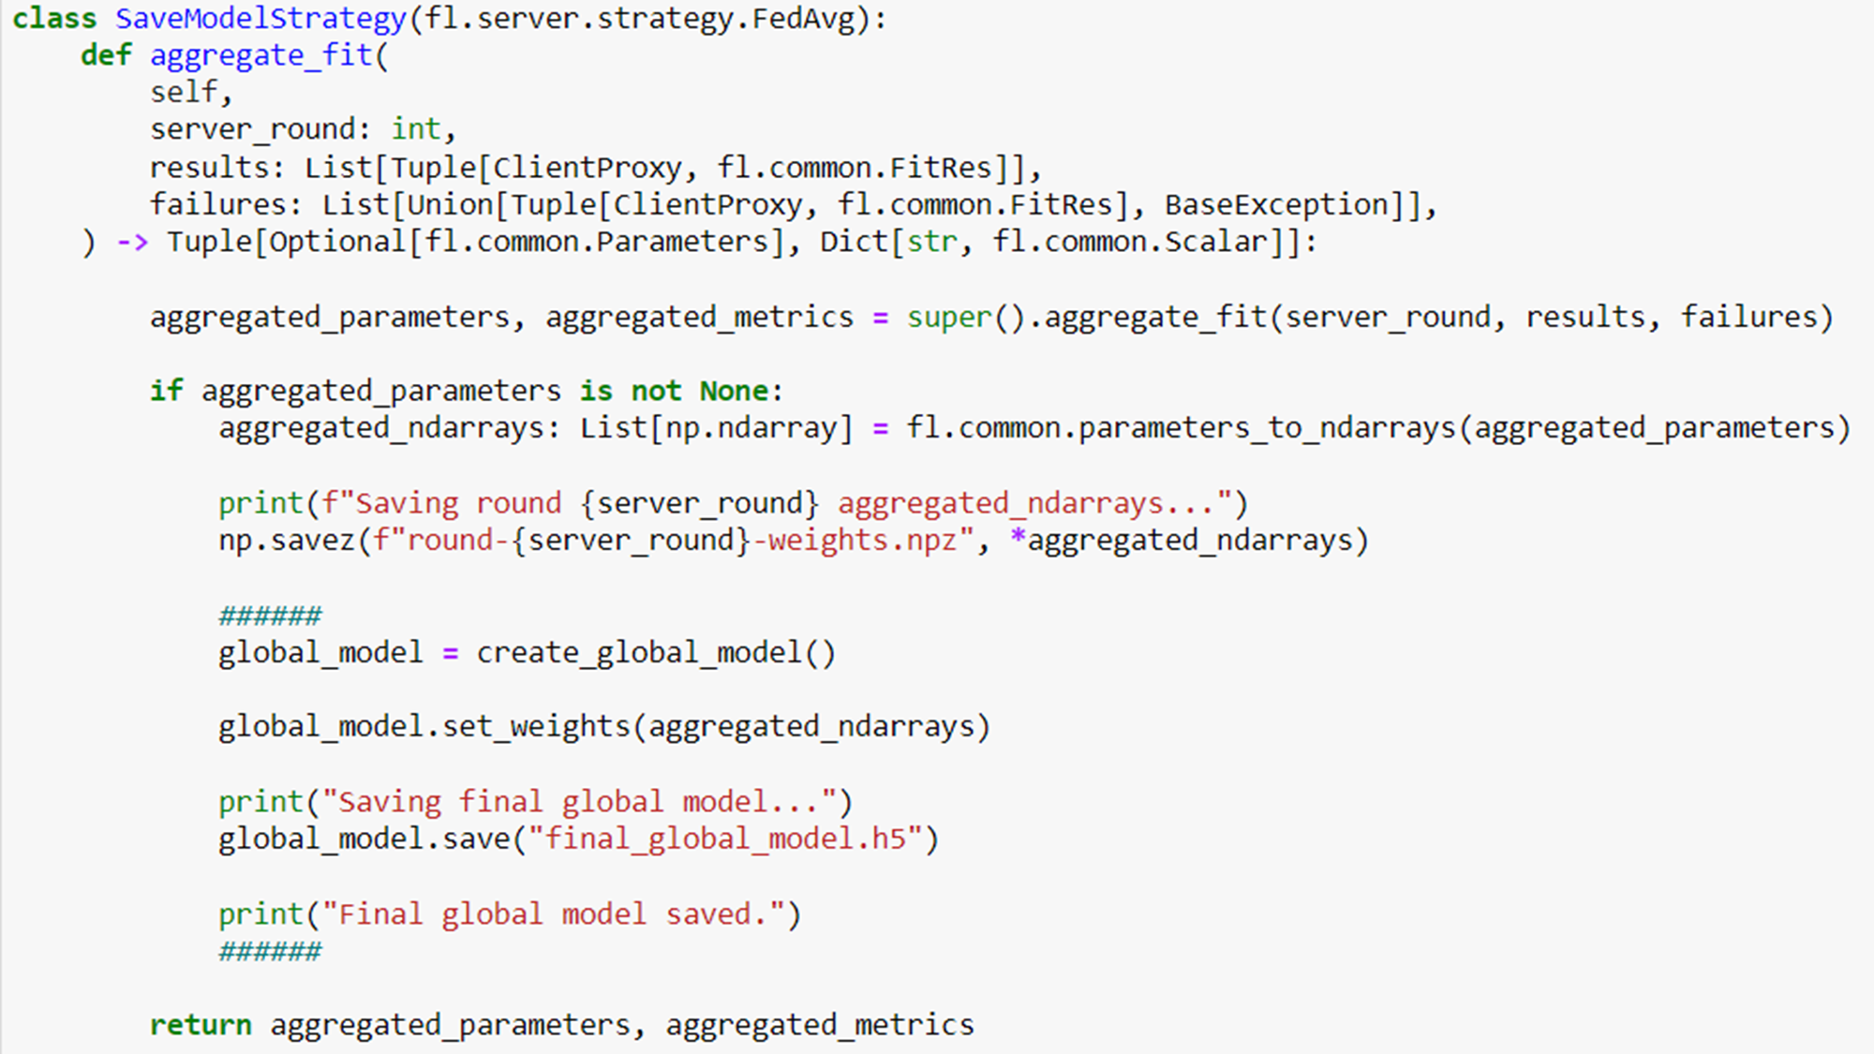
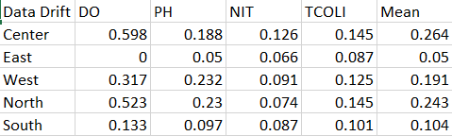
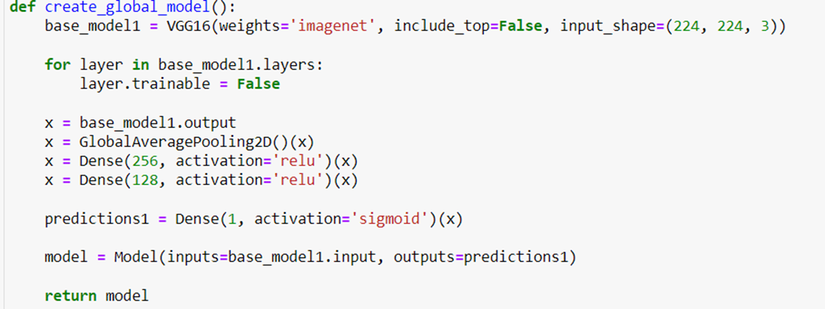
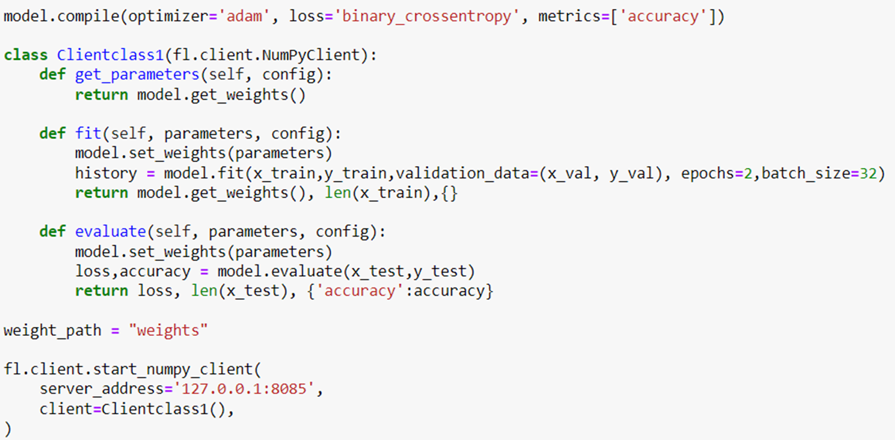
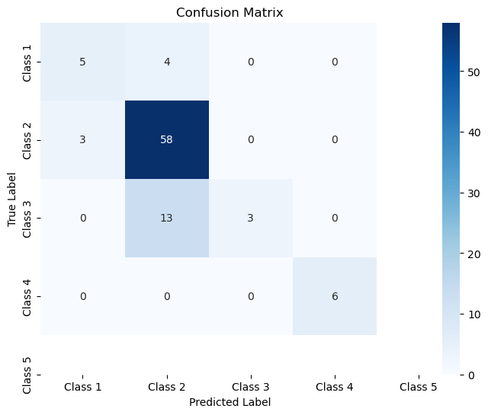
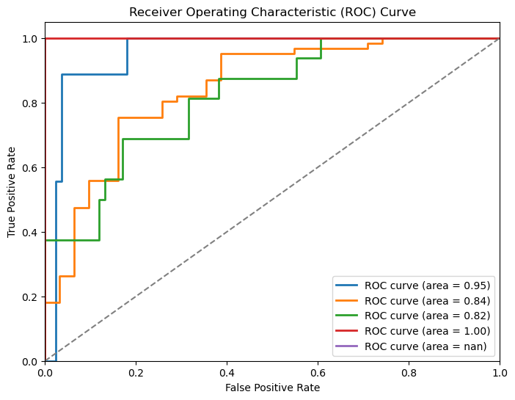
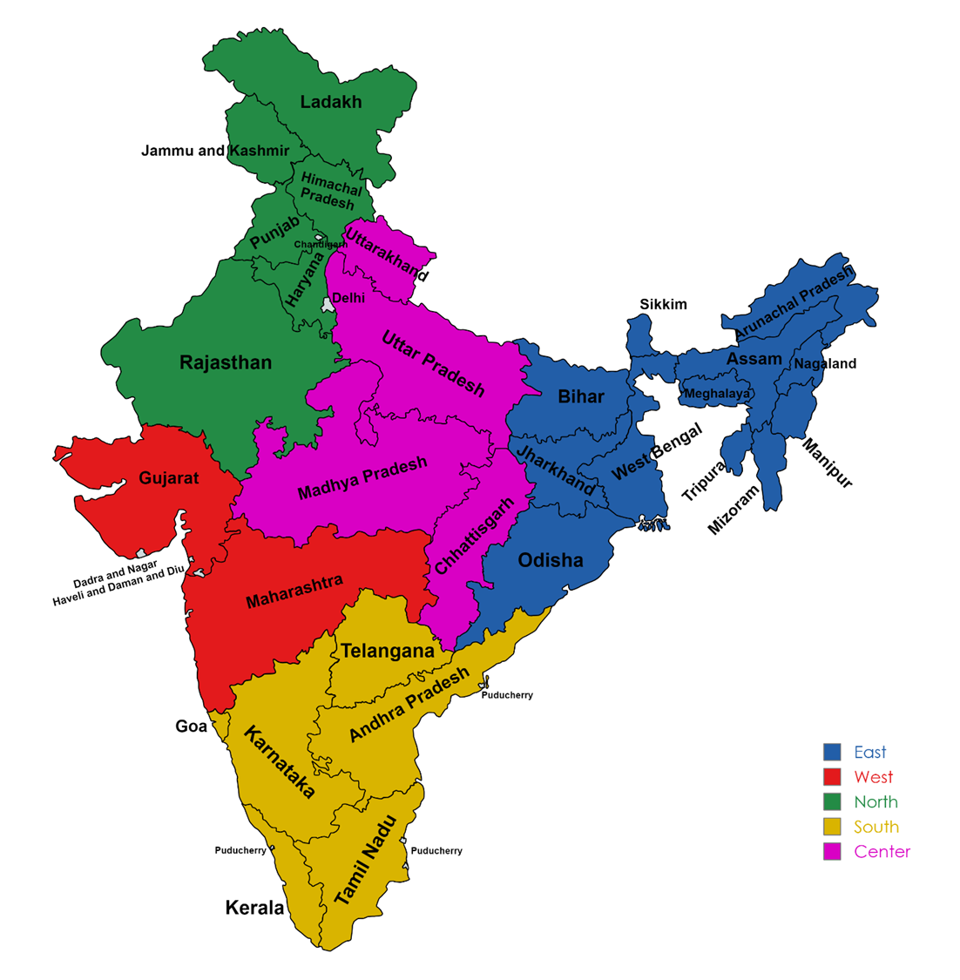
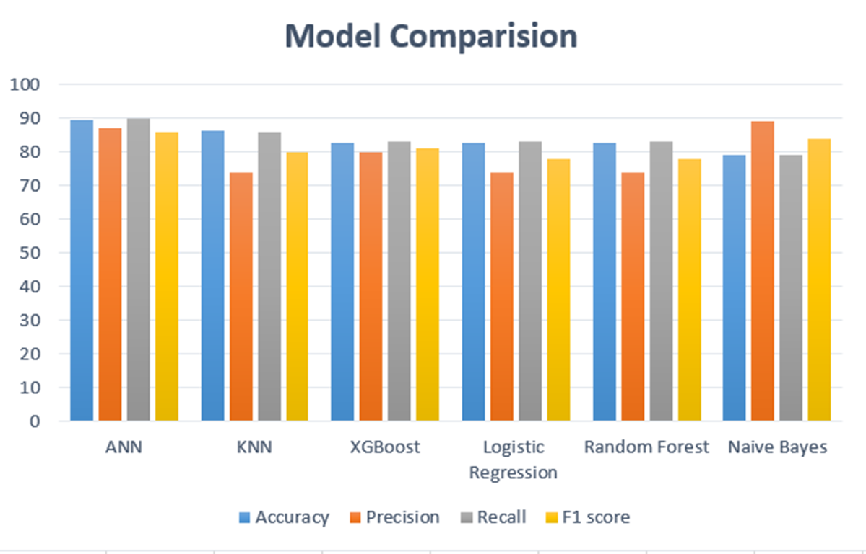
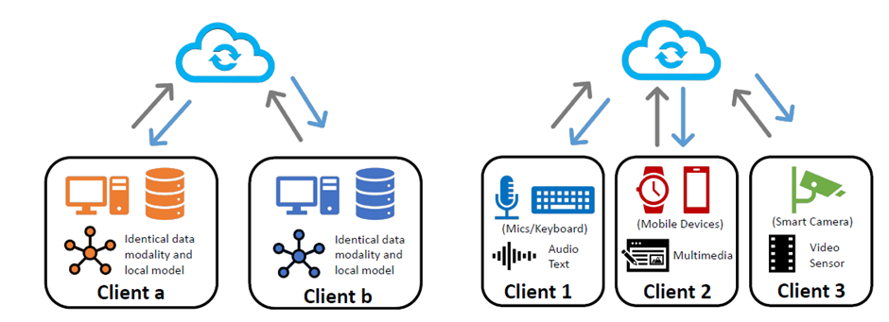
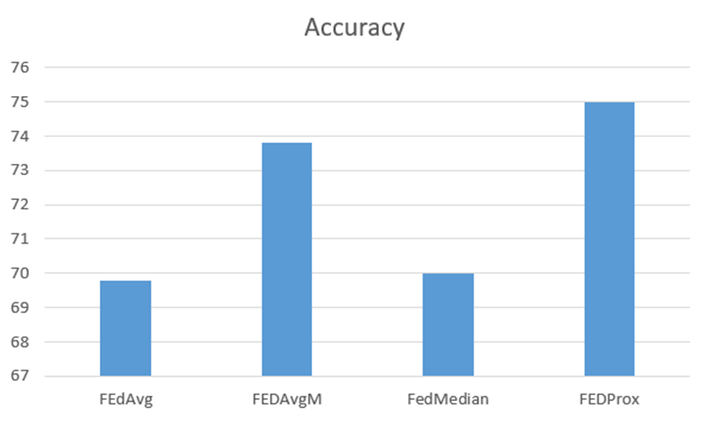
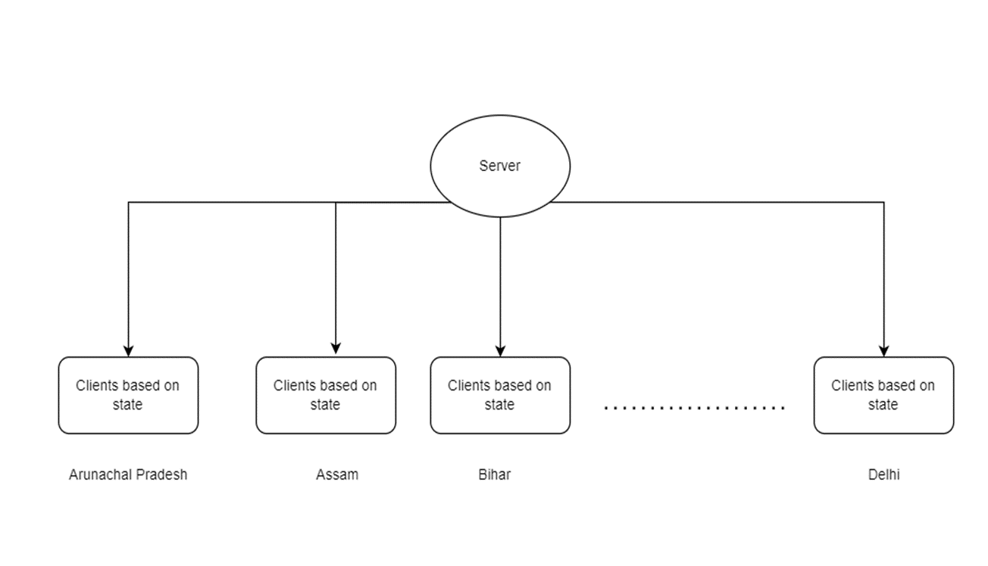
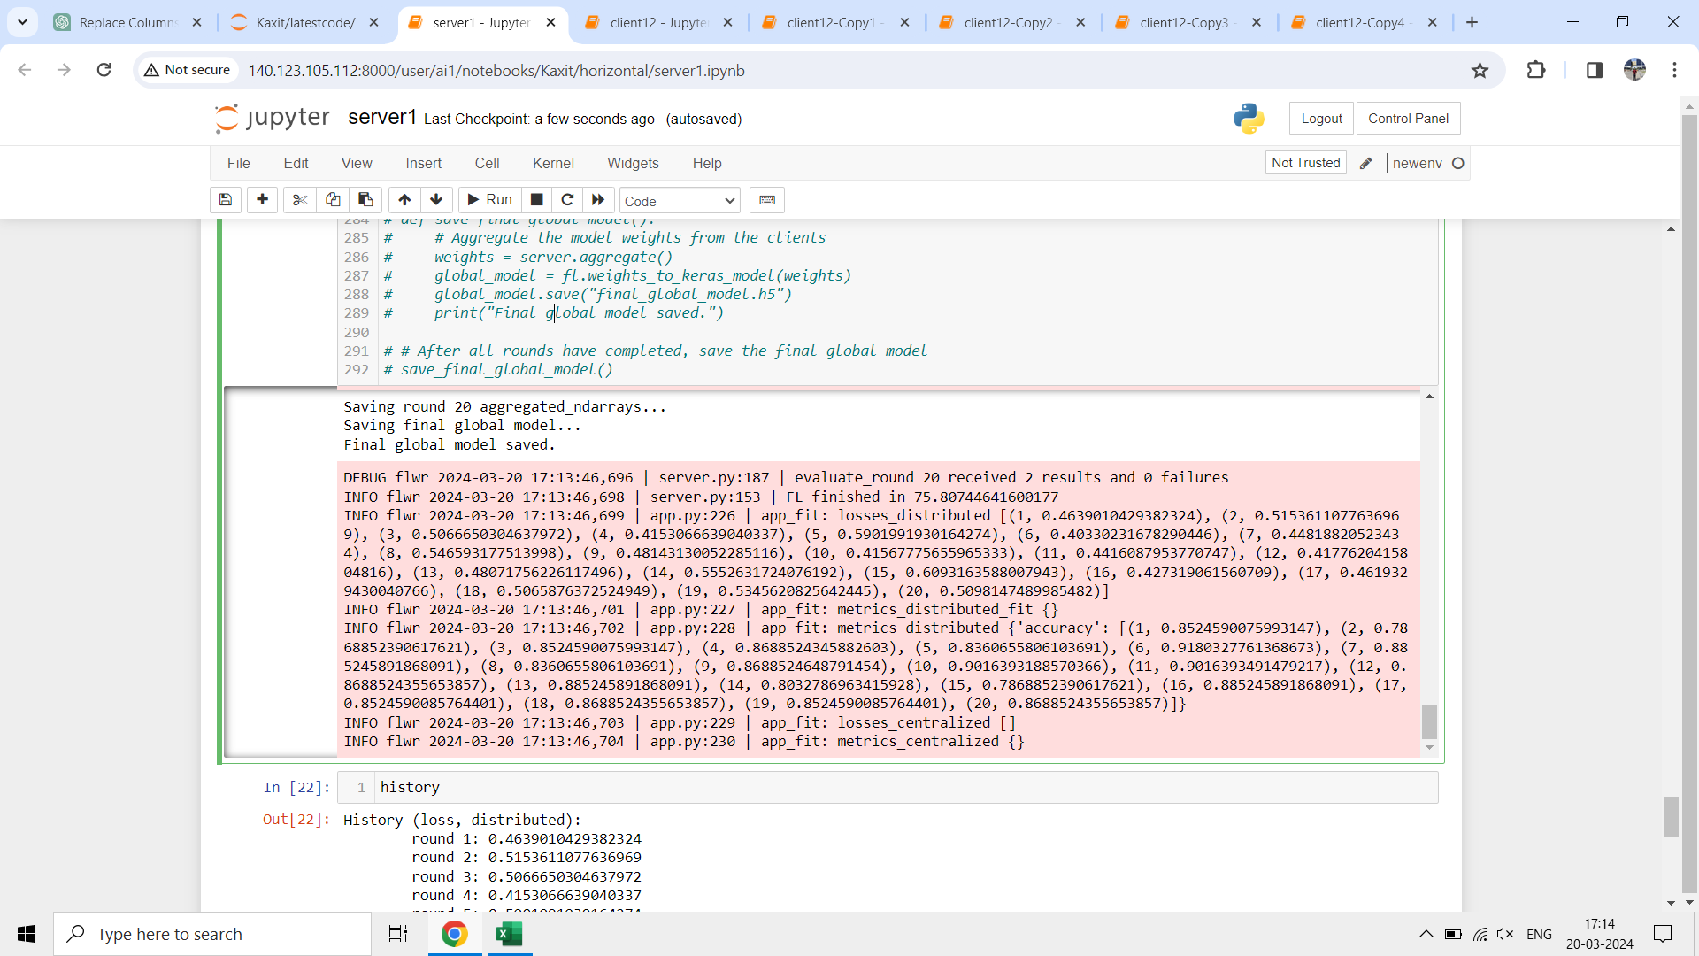
Drone based Water quality prediction using AI
Kaxit Pandya, Dr. Samir Patel, Pao-Ann Hsuing
Pandit Deendayal Energy University, Gandhinagar
BRIEF MOTIVATION
METHODOLOGY
EXPECTED RESULTS
Environmental monitoring often involves data collected from diverse sources, including drones capturing imagery and CSV files containing historical records. Federated Learning (FL) allows these decentralized data sources to collaborate without centralizing sensitive information, preserving data privacy and sovereignty.
FL enables model training across multiple parties without sharing raw data, addressing concerns about data privacy and security. This is particularly important for sensitive environmental data, where privacy regulations and ethical considerations mandate protection against unauthorized access or misuse.
By distributing model training across local devices or servers, Federated Learning reduces the need for centralized data processing and transmission. This enhances scalability and efficiency, enabling real-time analysis of large volumes of drone imagery and CSV data without incurring significant computational overhead.
Implemented Federated Learning on Image and csv data
Used 4 different aggregation strategies and Compared them
Data drift implementation for dividing Zones
Satisfying factors of Trustworthy AI
Privacy: Federated Learning
Robustness: Accuracy, Number of Clients
Fairness: Class Imbalance Ratio
Explainability: SHAP (Feature Importance)
Federation: Aggregation Algorithms (FedProx, FedMedian, FEdAvgM, FedAvg)
Server Side
OUTCOMES
2 groups of csv data: Center, North: 92% East, west, south: 74%
Drone Image data:
7 months data: 83%
Communication Round = 20 Epochs = 30 Aggregation Strategy = FedProx (proximal_mu = 0.9)
Applied SHAP on the final model
OBJECTIVE
Privacy of Data has been one of the top most priority of this project
Drone Images have been used from Satluj river
In Federated Learning, Data is not passed from client to server but rather, client trains its own data on local model and passes their weights to server, the server then aggregated the weights using several aggregation strategies and passes final weights to client. Several rounds of communication can be performed between server and clients.
Flower Framework has been used to implement Federated Learning
Client Side
BIBLIOGRAPHY/ REFERENCES
Sargaonkar, Development of an Overall Index of Pollution for Surface Water Based on a General Classification Scheme in Indian Context, https://doi.org/10.1023/A:1025886025137
Beutel, Flower: A Friendly Federated Learning Research Framework, https://doi.org/10.48550/arXiv.2007.14390
Tian Li, Federated Optimization in Heterogeneous Networks, https://doi.org/10.48550/arXiv.1812.06127
Ministry of Home Affairs, https://www.mha.gov.in/en/page/zonal-council
Qiying Yu, Multimodal Federated Learning via Contrastive Representation Ensemble, https://doi.org/10.48550/arXiv.2302.08888
Dong Yin, Byzantine-Robust Distributed Learning: Towards Optimal Statistical Rates, https://doi.org/10.48550/arXiv.1803.01498
CONTACT
Kaxit Dhavalkumar Pandya
National Chung Cheng University
Email: kaxitpandya@gmail.com
Phone: 9998861602

